Slide 1

SIG React 24-07-2018

Slide 2
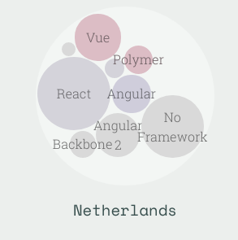
React
5 years old & made by facebook
Most popular JS framework
Unopinionated
Component based
Spawned React Native
Awesome
Stateofjs.com
Titel van de presentatie
1

Slide 3
Components
Components:
Are reusable blocks of code
Render JSX
Can be passed properties when called
Have their own state
Titel van de presentatie
1

Slide 4

Components
Tweakers.net
Titel van de presentatie
1

Slide 5
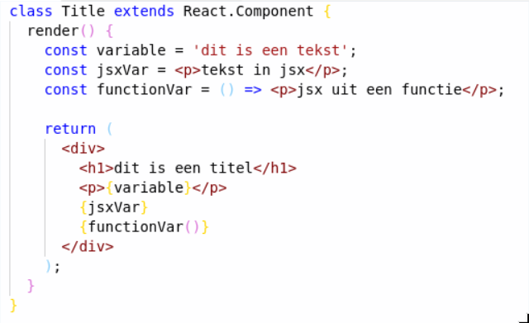

JSX
Titel van de presentatie
1

Slide 6
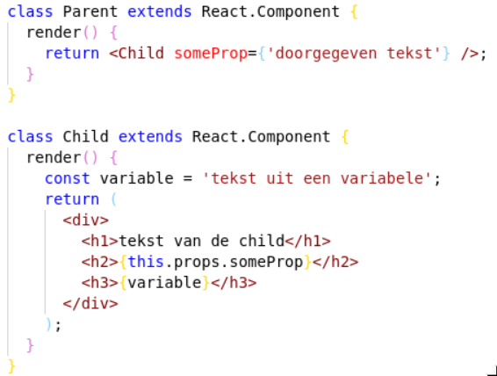

Props
Titel van de presentatie
1

Slide 7
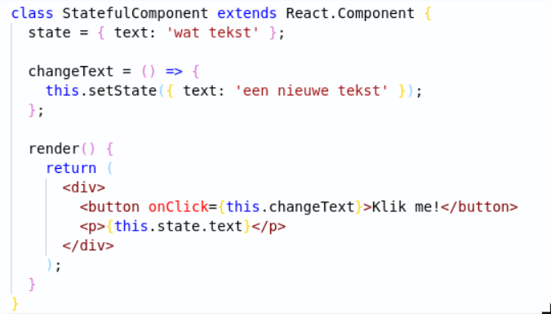


State
Titel van de presentatie
1

Slide 8

Hands-on Time!
Questions?
Titel van de presentatie
1

Slide 9
Hands-on: Editing JSX
Suggestion: use VS Code with ESlint plugin for error-checking
Git clone https://github.com/AMIS-Services/react-series
Cd into dir exercise, run `yarn install` and `yarn start`
Inspect the page in your browser
Edit the JSX in the file src/App.js to show AMISBnB as a title
Titel van de presentatie
<number>

Slide 10
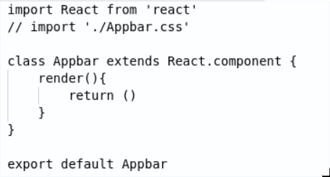
Hands-on: Creating a component
Create the folder src/components
Create a new component by adding a file named Appbar.js with the code shown below.
Add JSX to the return of the render method.
Add some styling in a .css file and import the css file
Import and use the component in src/App.js
Titel van de presentatie
<number>

Slide 11
Hands-on: passing props to your component
Pass a prop to your Appbar ( `<Appbar propName=’a string’ />`)
Use this prop in the Appbar (availabe with `this.props.propName`)
Try using multiple Appbar components in your App.js with different values for your prop
Titel van de presentatie
<number>

Slide 12
Hands-on: displaying data
Import the data from the resources folder (`import { accomodations } from ‘src/resources/accommodations.js’`)
Use accommodations.map(() => {}) to display a div with the accommodations name for each accommodation
Move the rendering of the accommodations to a separate function called renderAccommodations which should JSX. Use it by changing the map function to: `accommodations.map(this.renderAccomodations)`
Display more of the data from the accommodations objects. Add some styling.
Titel van de presentatie
<number>

Slide 13
Hands-on: move accommodation to it’s own component
Create a new .js and .css file for Accommodation. Add the required code to export a component from these files and move the rendering of an accommodation to this component.
Move the css you used to style the individial accommodations from Accommodations.css to the new css file
Display the component <HomeIcon /> from the resources folder in your new Accomodation component. Have its color be based on favorite being true or false.
Titel van de presentatie
<number>

Slide 14
Hands-on: using state
Have the HomeIcon be shown dependent on state rather than props by adding a this.state.favorite to your Accommodation component
Add a function to toggle the value of this.state.favorite using `this.setState()`
Add an `onClick` property to your HomeIcon which calls the function you just wrote
Titel van de presentatie
<number>

Slide 15
Hands-on extra: displaying favorites at the top
Display the accommodations which have `favorite === true` a second time at the top of the page
Make sure that the toggleState will still work by keeping the state in the parent component and passing down the toggle function to the child
Titel van de presentatie
<number>

